Slide 1
Progress Report (20th Week)
Yzm
06/26/2020

Slide 2
Non-Local
Heterogeneous Non-Local Fusion
for Multimodal Activity Recognition
Petr Byvshev
Aalto University
Espoo, Finland
Pascal Mettes
University of Amsterdam
Amsterdam, Netherlands
Yu Xiao
Aalto University
Espoo, Finland
ICMR ’20, October 26–29, 2020, Dublin, Ireland Proceedings published June 8, 2020
Notes:
周安福，北京邮电大学计算机学院教授，博士生导师, 智能感知、物联网系统、AI-driven数据传输

Slide 3
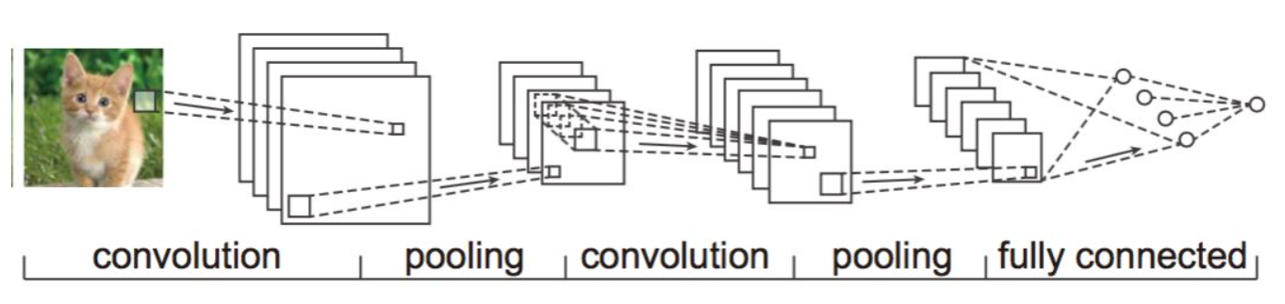
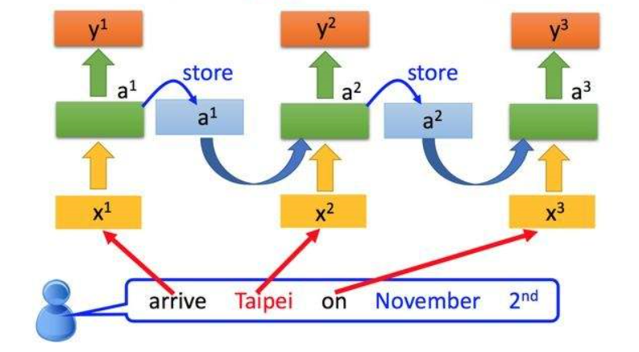
Local Neural Networks
A typical example of CNN
A typical example of RNN
Non-local与local的对比

Slide 4
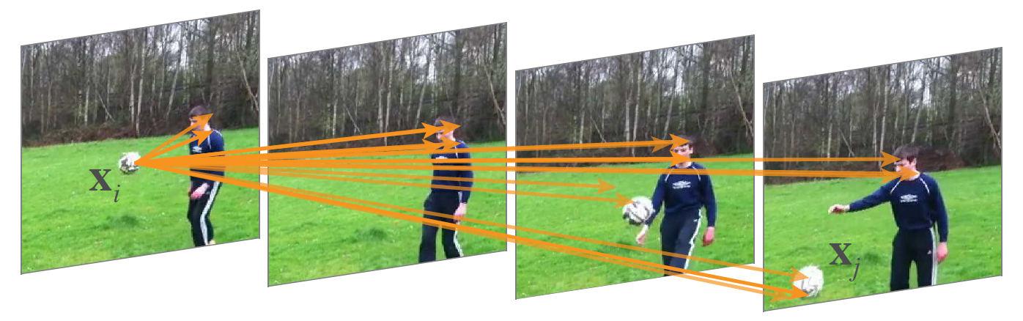
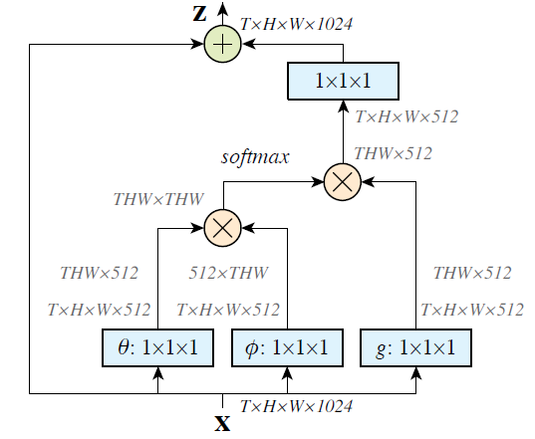
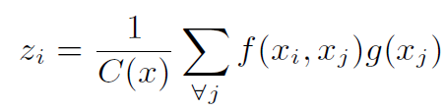



Non-Local Neural Networks
A typical example of Non-Local Neural Networks
Problem Formulation
公式的物理意义：图和公式对应
为什么这样做

Slide 5
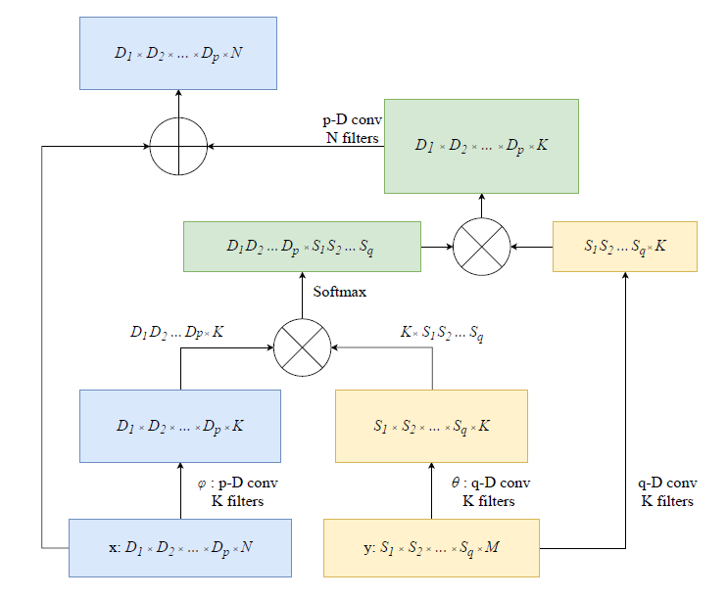
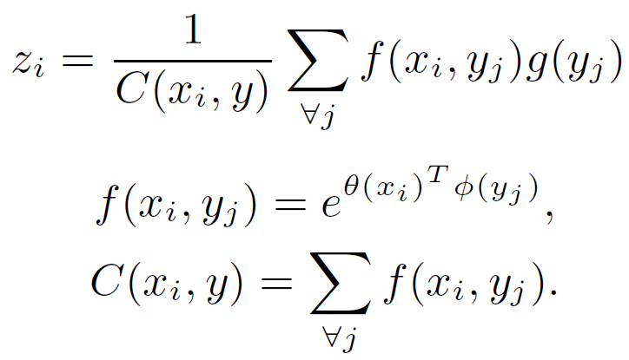

Non-Local Fusion
Problem Formulation
The Non-Local Fusion block
为什么多模态可以利用这个公式融合
动手实现代码

Slide 6
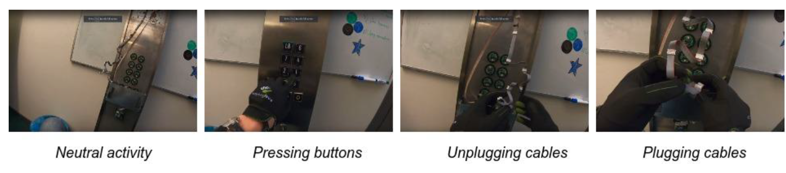
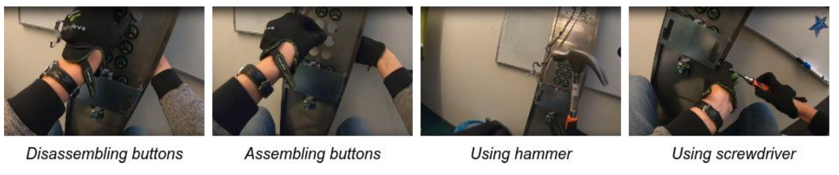
Dataset
The GloVid dataset
The dataset consists of eight activities , centered around elevator maintenance.
定义
挑战
问题分解

Slide 7
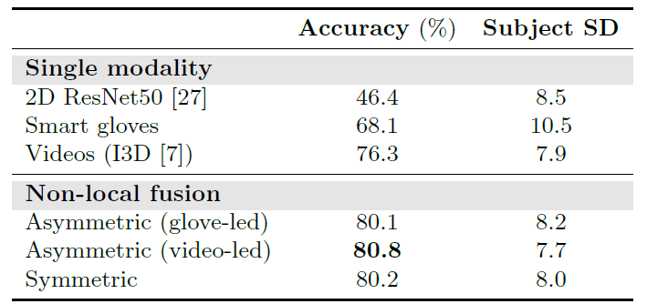
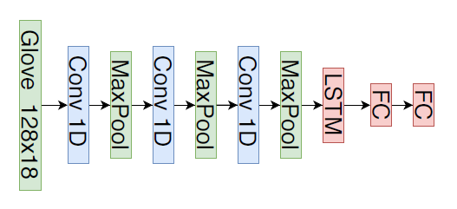
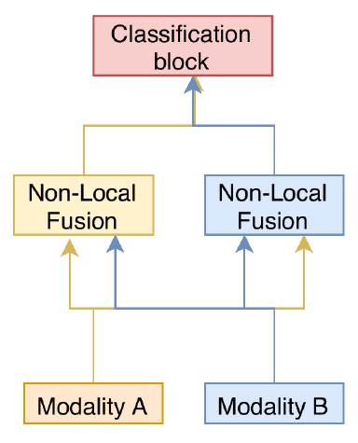
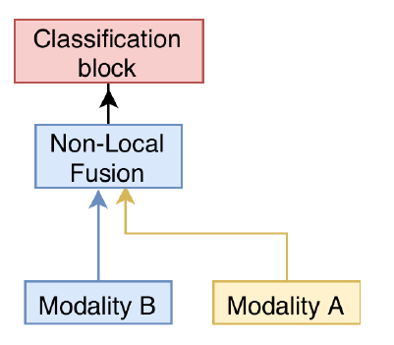
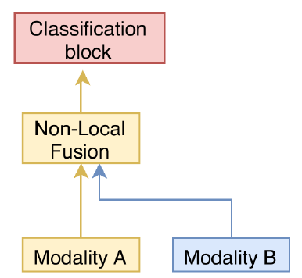
Comparative evaluation

Slide 8
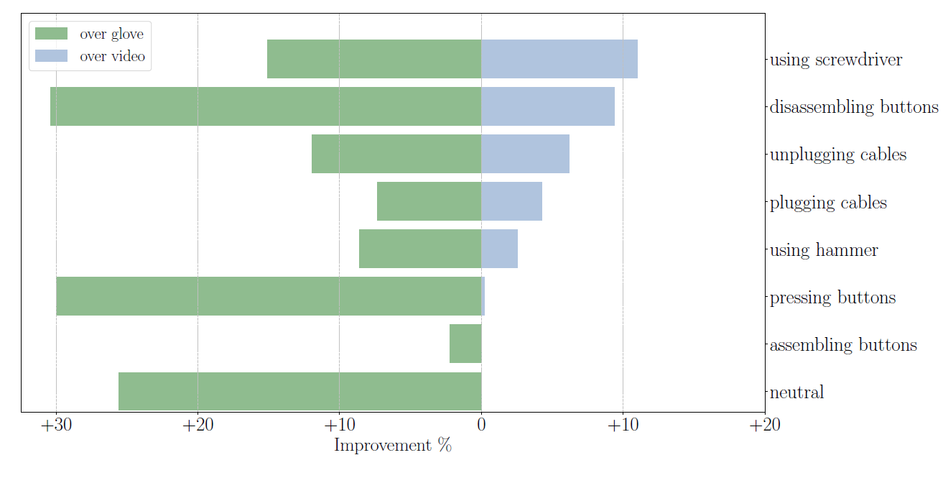
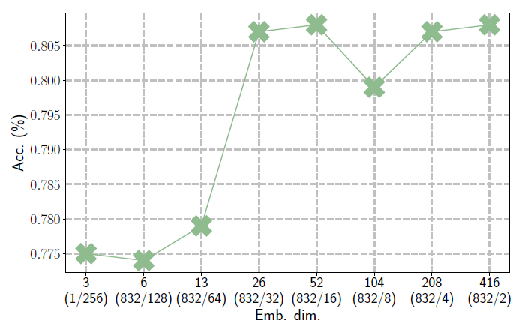
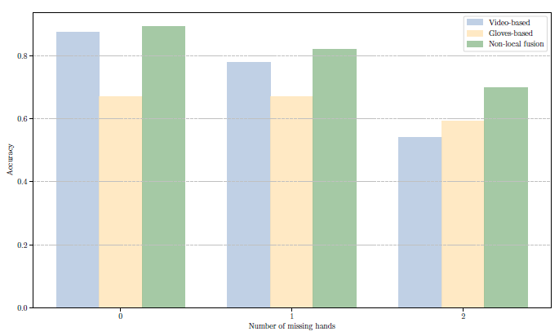
Quantitative Analysis

Slide 9
summary
Key point：Make the channel dimensions of the same size K.
The glove sensor can be replaced by IMU.
Can we use the CSI signal as input ?
Can we change the K filters to N filters to improve Computational efficiency of The Non-local Block ?

Slide 10
Thanks!

Slide 11
要求：
写文档
1.一段话（中文描述paper的工作）
2.最相关的工作
3.主要方法和挑战
4.记录实验部分的dataset和评估指标
5.感想

